Slide 1

Media Bazaar
Matei-Cristian Mitran
Ioan-Nicolae Popa
Plamen Peev
Aleksej Borisov
Notes:
Hello, today I will be presenting you our project about Media Bazaar. Let's begin.

Slide 2
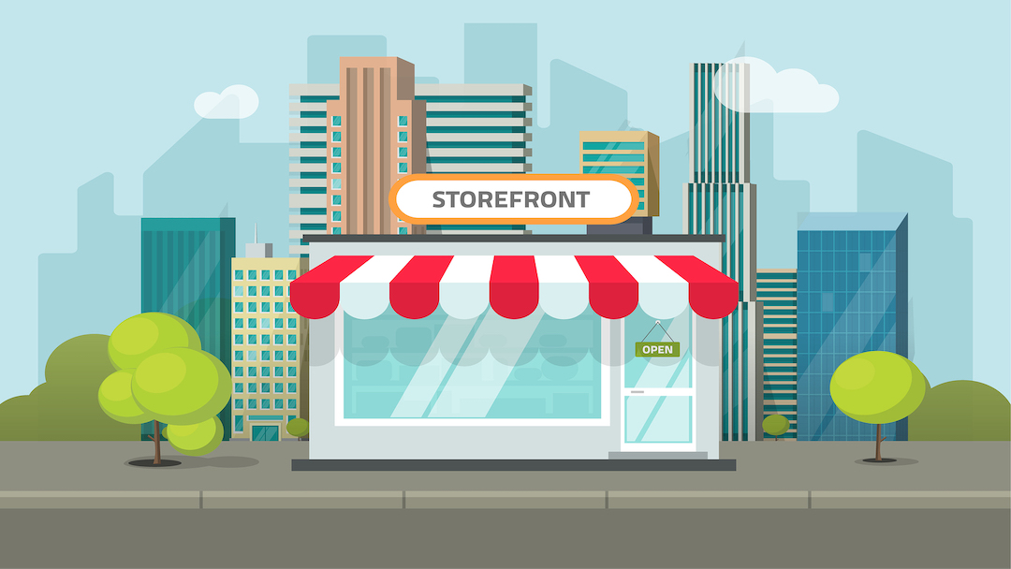
Problem
The company Media Bazaar is planning to open their first shop in Eindhoven!
Notes:
The company Media Bazaar is planning to open their first shop in Eindhoven. They tasked us to deliver a software application
and a website in order to help them manage their employees, their stock and board of directors.

Slide 3
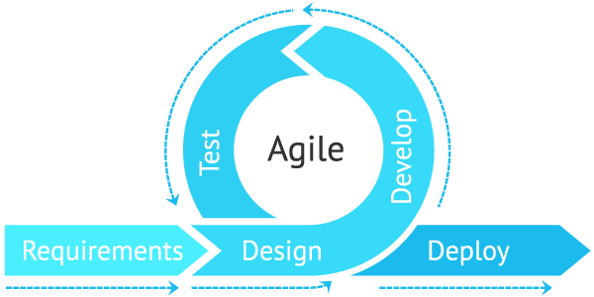
Way of Working
Notes:
First of all, for this project, our team used the Agile method of working.
The iterative or AGILE method of working is the method in which the work is repeated in cycles known as iterations,
therefore, the team’s understanding of the user requirements and products increases by each cycle.

Slide 4
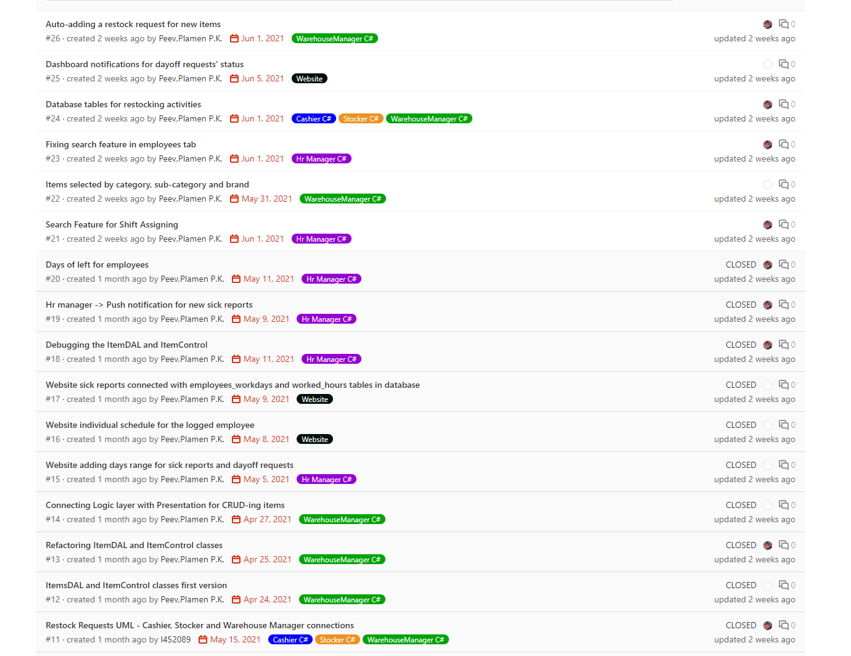
GIT
During the course of this project, we have used GIT version control system, helping us organize the project and divide the work among us.
Notes:
During the course of this project, we have used GIT version control to manage our product's version and help us organize the project
and divide the work evenly among us. This is a picture of our issue dashboard.

Slide 5
Deliverables
Software application for cashier, stocker, warehouse manager and HR manager
Website for employees and board of directors
Notes:
To help fix Media Bazzar's problem, our team will deliver two things. A software application for the cashier, stocker, warehouse manager
and human resources manager and a website for employees and the board of directors.

Slide 6
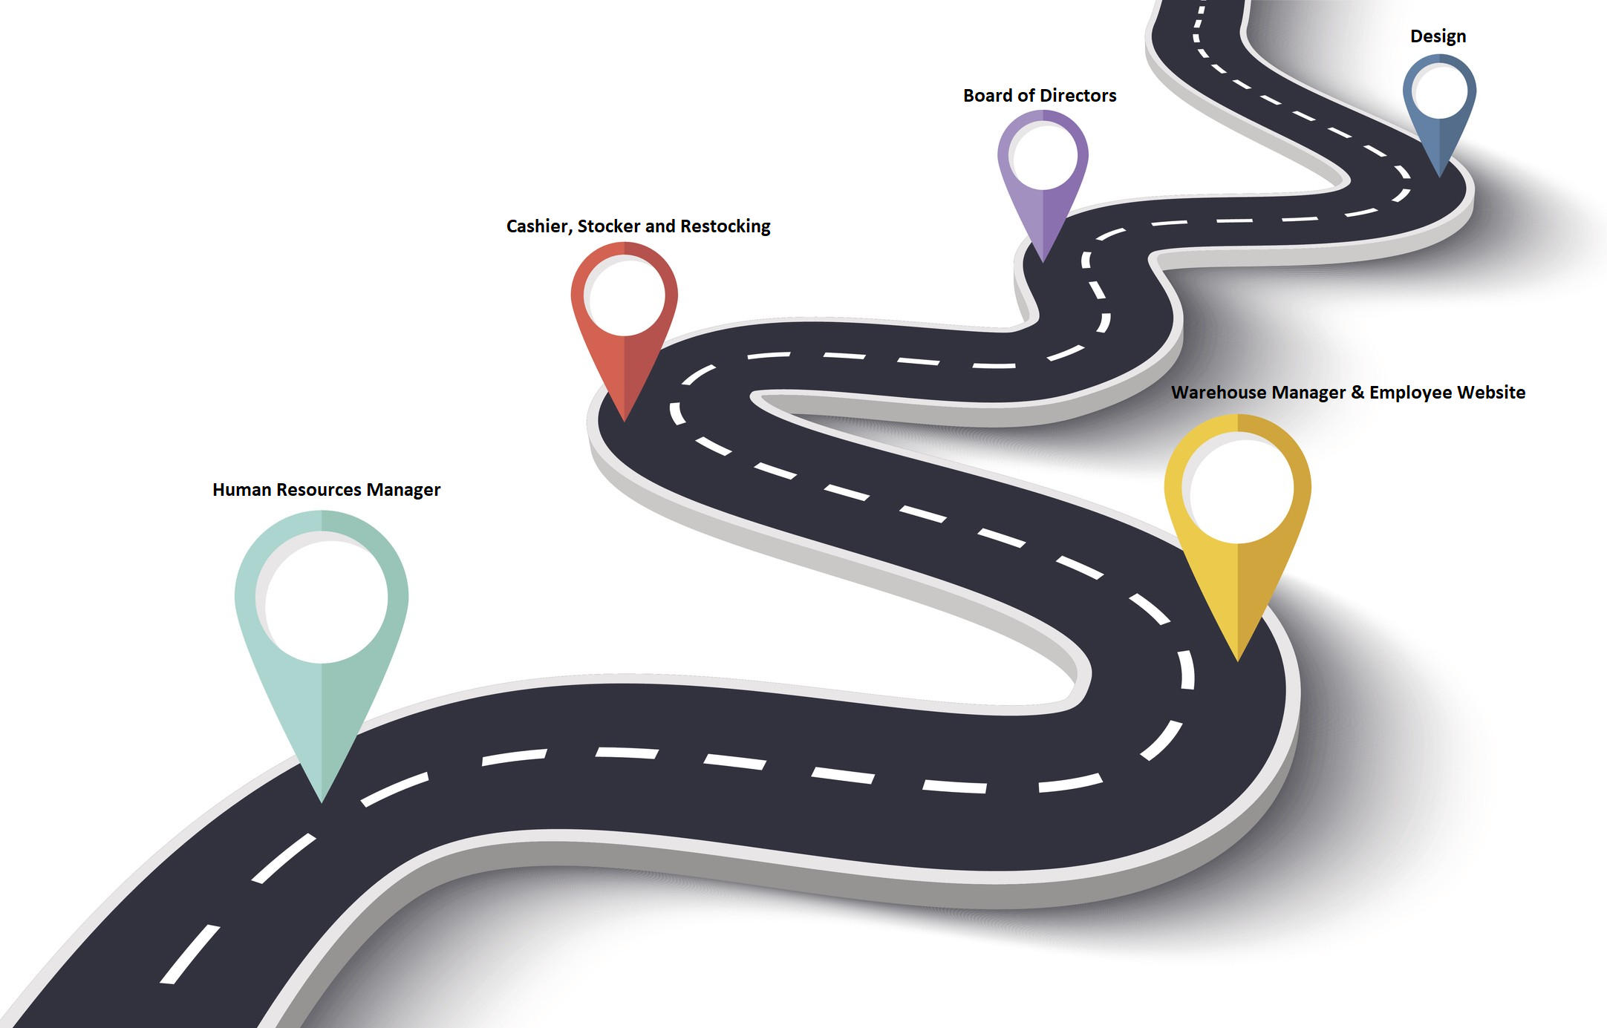
Roadmap
Notes:
First of all, we started this project by developing a UML diagram and wireframes for the application. Then we began developing.
We started with the human resources manager, which was the most time consuming part. We developed the Employee CRUD, scheduling, day off and
sick reports. Then we moved onto the warehouse manager part. We quickly developed the item CRUD and then moved onto the employee website.
After that, we moved on to the restocking process, where we finished the cashier and stocker part of the application. Then we started making
the board of directors part of the website, which features statistics for items and employees. Finally, we polished up the design.

Slide 7
Start vs End
We have updated our design a lot to please our client
Here are some examples:
Notes:
As mentioned in the previous slide, we worked a lot on our design to make it as eye pleasing as possible. Here are some examples:

Slide 8
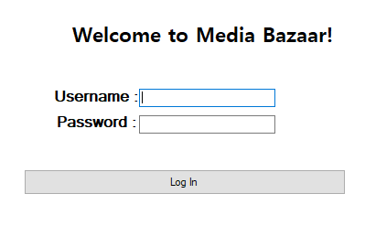
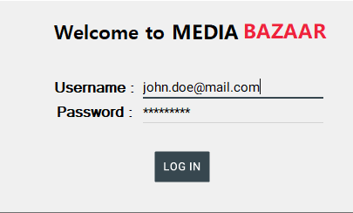
Login Screen
Start
End
Notes:
Here is the log in screen before and after.

Slide 9
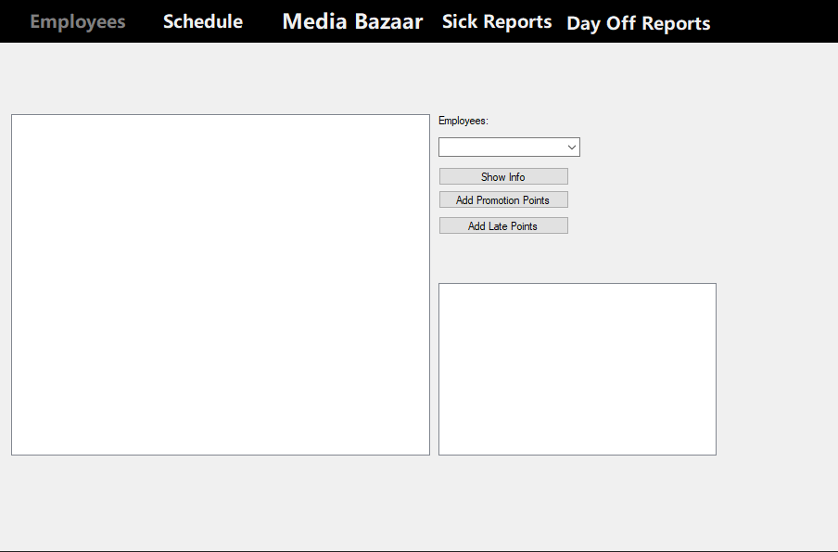
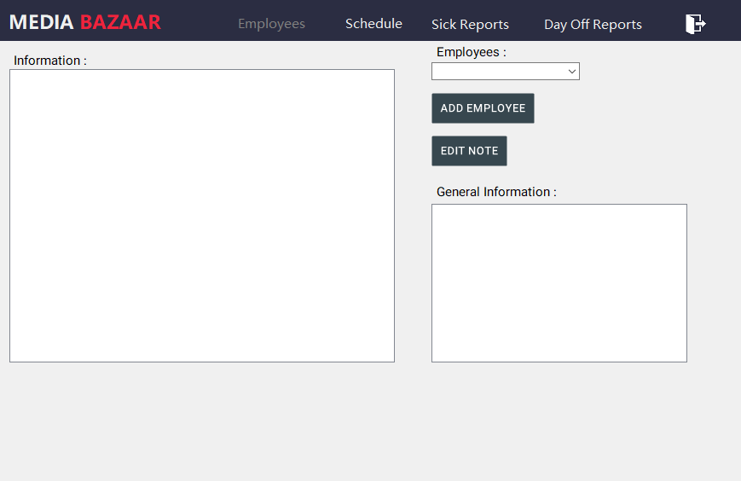
HRManager Form
Start
End
Notes:
Here is the HRManager home before and HRManager home after

Slide 10
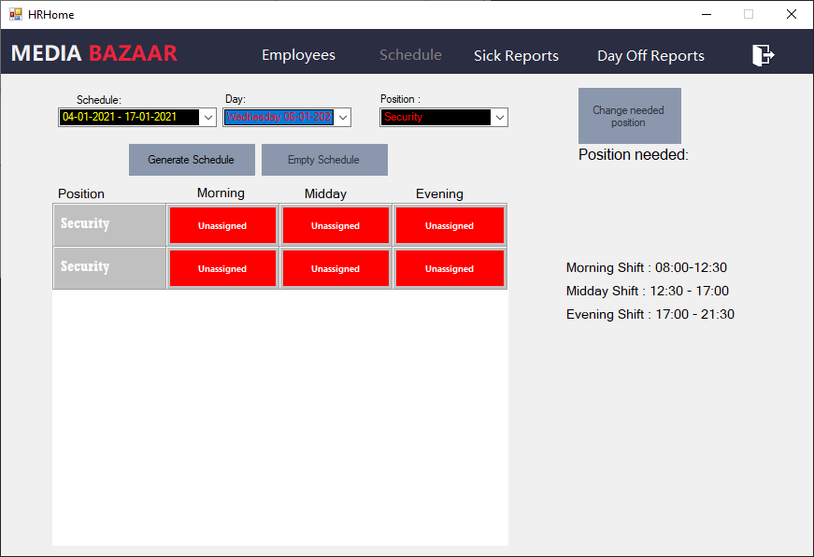
Highlight
We are most proud of the automatic scheduling system designed to help the human resources manager assign shifts to employees!
Notes:
The feature we are most proud of is the automatic scheduling system designed to allow the human resource manager automatically assign shifts to
employees.

Slide 11

Conclusion
Notes:
With the help of the functionalities implemented by us, the problems in question will be fixed.

Slide 12
Demo
5 min

